Slide 1
MINIBUS DRIVER
Recruitment pack
JUNE 2025

Slide 2
Meet our Headteacher
Thank you for your interest in joining Team Grove!
I proudly began as Headteacher here in January 2024. The Grove School has a huge amount of potential, and we are looking for the right members of the team to truly drive us into a new era.
Our ambitious plans are centred around the relentless mission of ensuring that our students have the very best life chances. We have a clear focus on wellbeing and staff development, and we are supported by The Marches Academy Trust who open up huge opportunities for personal growth.
We are looking for staff who are positive, research-informed and are able to be agile in their thinking. Aspiring to work in a fast paced school which will drive forward change within our community. Our culture is positive, inclusive and innovative as we strive to be ever -improving practitioners who make success inevitable.
If this seems like a place where you can thrive, please come and join us on our exciting journey to making our school great.
Mitch Allsopp
Headteacher

Slide 3
Job description
We offer
An ‘Outstanding’ curriculum and learning experience for our young people.
Excellent professional learning and support at every stage in your career, with opportunity for continued personal development through our Talent Pathway Career development opportunities including funded NPQ qualifications.
Funded monthly professional life coaching for Headteachers.
An enthusiastic and supportive team of staff, parents and governors
A core belief in staff wellbeing and work life balance for all, evidenced in policy and practice.
Year-round free access to our fitness suite.
Benefits including funded counselling, physiotherapy and GP and other medical support.
Spacious Sixth Form Facilities and excellent outcomes.
Purpose
To be a casual minibus driver for the school's home / school transport provision; including routine safety checks on the vehicles.
Why this role above others?
You will be part of a team that has a variety of backgrounds, all offering support and guidance to each other, which creates a positive and hardworking ethos. They go above and beyond to ensure the smooth running of the school helping all students achieve.
Any questions in regard to the role can be raised with Susan Thorley ahead of the closing date: Susan.Thorley@gro.mmat.co.uk
Post title
Minibus Driver
Salary
Grade 4
Hours of work
Part-time
Post status
Permanent

Slide 4
Responsible to:
Headteacher, Operations Manager
Main Duties:
Operating our bus routes, collecting children from given pick-up points along the route and delivering them to school and collecting them from school and dropping them back at the given points
Taking students to specified locations
Ensuring that the minibus is kept clean and in good condition, including, but not restricted to:
Cleaning of the bus, both inside and out
Ensuring signs inside the bus are properly attached and in good condition
Ensuring that any additional work required is communicated immediately to the Operations Manager
Adhere to all school policies including Health and Safety guidelines for minibus drivers
Liaise with the Operations Manager regarding bus schedule and bookings on a regular basis
VEHICLE SAFETY - To carry out a check before leaving school, completing a Safety Check Record of the following (plus a weekly check on wheel nuts): • Oil level • Fuel • Coolant • Tyres • Windscreen wipers and washer level • Lights • Horn/mirrors • Brakes
Responsibilities
Be aware of and comply with policies and procedures relating to child protection, health, safety and security, confidentiality and data protection, reporting all concerns to an appropriate person.
Be aware of and support difference and ensure equal opportunities for all.
Contribute to the overall ethos/work/aims of the school.
Appreciate and support the role of other professionals.
Attend and participate in relevant meetings as required.
Participate in training and other learning activities and performance development as required.
Standards and quality assurance
Uphold department, school and Trust procedures, policies and plans.
Represent the Faculty in cross-curricular working parties.
Attend Faculty, Year Team meetings and events to fully support the department, the school and the Multi-Academy Trust.
Attend relevant CPD and meetings within the Trust and with outside agencies.

Slide 5
Developing self and leading others:
Take responsibility for own professional development including maintaining an up to date knowledge of developments and related legislation including engaging fully in performance management of self and other staff (if applicable)
Contribute to effective staff induction and professional development
Manage own workload, providing support where necessary and delegating where appropriate to ensure that professional duties are fulfilled, as identified
Community responsibilities:
Effective dialogue with parents in accordance with school policies.
Attend and support community events as required.
In addition to the above all Marches Academy Trust staff are required to:
Adhere to policies and procedures, including Equalityand Diversity and Health and Safety.
Respect confidentiality: all confidential information should be kept in confidence and not released to unauthorised persons.
Undertake appropriate training and development as required.
Participate in the Performance Review Cycle.
Demonstrate excellent Customer Care in dealing with all customers.
Ensure positive effective working relationships with the school teams, stakeholders and partners.
Objectives and outcomes:
To be agreed with the successful post-holder once appointed.
The duties may be varied to meet the changing demands of the school at the reasonable discretion of the Headteacher.
The post holder may have opportunities to work in other schools within The Marches Academy Trust.

Slide 6
Person specification
 | Essential | Desirable
Qualifications and training | Clean, full UK Driving licence with Category D1 | First Aid qualification. (Training will be given) 3 GCSEs including Maths and English
Experience | Working knowledge of Health and Safety rules Experience of vehicle maintenance | Experience of working in an educational setting or other relevant environment
Knowledge | Ability to carry out vehicle safety checks | School operations Health & Safety

Slide 7
Person specification
 | Essential | Desirable
Skills | Ability to work unsupervised Prepared to work shift patterns, additional and/or unsociable hours as required to complete tasks Ability to respond flexibility as needs arise
Personal qualities | Good communication skills Friendly & approachable Reliable Ability to work well on own initiative Work well as part of a team Flexible Ability to maintain confidentiality
In addition to candidates’ ability to perform the duties of the post, the interview will also explore issues relating to safeguarding and promoting the welfare of children including:
Motivation to work with children and young people
Ability to form and maintain appropriate relationships and personal boundaries with children and young people
Emotional resilience in working with challenging behaviour.
Positive attitude to use of authority and maintaining discipline.

Slide 8
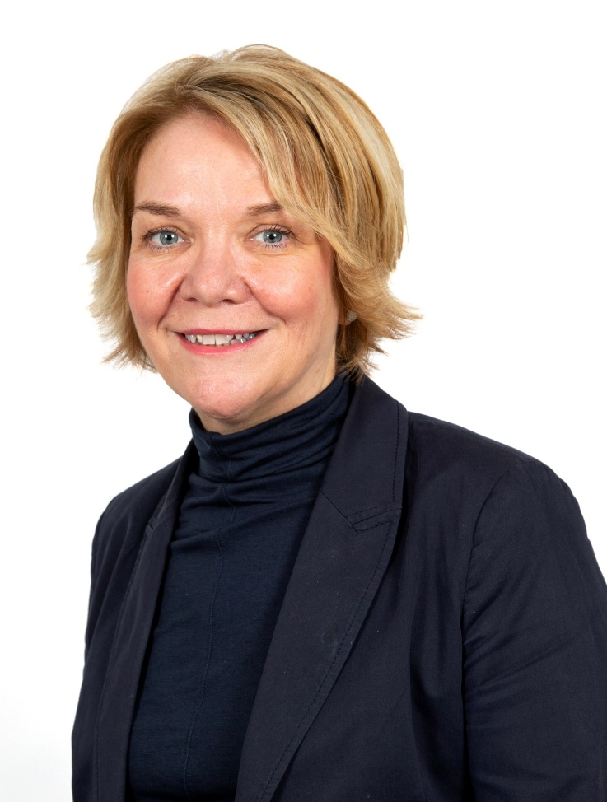
Welcome from the CEO
This is a high achieving Trust that is imaginative and creative in its approach to teaching and learning and is keen to look for continued sustained improvement.
Our vision of ‘Achievement through Caring’ is central to all that we do at The Marches Academy Trust. Our schools are innovative and striving to ensure that young people make the very most of their learning adventure and are equipped with the skills required to prosper in the modern world.
We are immensely proud of the Alliance of Leading Learning who provide a wide range of professional development opportunities across our Trust, nationally and internationally.
Our family of schools currently includes:
The Marches School and Sixth Form in Oswestry
Sir John Talbot’s School and Sixth Form in Whitchurch
Tilstock CE Primary School and Nursery in Whitchurch
The Grove School and Sixth Form in Market Drayton
Lower Heath CE Primary School and Nursery in Lower Heath
Shrewsbury Academy in Shrewsbury
Longlands Primary School and Nursery in Market Drayton
Grange Primary School and Nursery in Shrewsbury
Oakmeadow CE Primary School and Nursery in Shrewsbury
Woodlands School in Wem
Idsall School and Sixth Form in Shifnal
CEO
The Marches Academy Trust

Slide 9
Meet our Chair of Trustees
Thank you for your interest in this role.
The Trust is looking to appoint an individual to build on our Trust's current strengths and achievements.
As a thriving Trust serving over 6,000 students and their families in Shropshire, this a pivotal role in driving continuous improvement across our schools and will contribute to our vision of 'achievement through caring'.
Collaborative working with other schools in our Trust offers many benefits for students and staff; sharing best practice in teaching and learning, curriculum collaboration, extracurricular opportunities, staff development, finance and human resources, legal services, school improvement structures and governance arrangements.
We hope that the opportunity to shape the work of our schools and their staff to harness their professional expertise, with the goal of securing excellent outcomes, is one you would relish.
The prospect of this role goes beyond the immediate job description. The successful candidate will influence and help shape the strategy of the Trust,
have the opportunity to support our ITT provision, support leadership development and career paths as well as drive efficiencies across our schools.
For the right individual, this is an exceptional opportunity. The right candidate will have no better chance of working with wonderful students, super staff and shaping our Trust into the future.
Chair of Trustees

Slide 10
Who we are
Interested? Here’s how to apply:
Complete the online form : Job Vacancies - Grove School and Sixth Form (groveschoolmarketdrayton.co.uk)
The closing date for applications is:
Monday 7th July 2025
Interviews will be held:
Thursday 10th July 2025
The Trust is committed to safeguarding and promoting the welfare of the children in our care and expect all
staff to share this commitment.
Welcome to the Marches Academy Trust!
We are a multi-academy sponsor based in Shropshire, currently comprising five secondary schools, five primary schools and one special school.
Across our Trust we have a wealth of experience to inspire and motivate children, young people and staff to be the very best they can.
Achievement Through Caring drives our Trust, and our values are shared throughout our family of schools; we work together on embedding them in everything we do.
Our Trust prides itself on delivering high quality education and connecting with our children and young people to inspire and enthuse them to learn, achieve and to be happy.
A core belief in staff wellbeing and work life balance evidenced in policy and practice

Slide 11
Our Trust Vision Statement and Values
Achievement through caring
As a Trust, it’s our mission to empower everyone in our Trust and our communities to live and breathe our values and Achievement Through Caring, to reach their full potential.

Slide 12
Our investment in you
Talent Spotting our Future Leaders
Our Talent Pathway supports the professional development of staff within the trust. We identify leadership talent and leadership needs for future succession planning – ensuring relevant and practical leadership development opportunities for staff.
Our talent management programme and our Career Development Pathways provide a framework for the discussion of your leadership journey and the professional learning you can access along the way.
Talent Contract
The Talent contract is a promise; a covenant between yourself and the trust that the Trust will do its’ very best to support and develop you professionally. The Contract describes a variety of Professional development opportunities and encourages you to identify and pursue your training needs.
We believe successful creative lifelong learners participate in a journey of self discovery. They know how to learn, acquire skills and feel safe to take risks with confidence and courage.

Slide 13
Our investment in you
Generous non-contact time for staff
We really care about employee wellbeing and our commitment is setout in our Wellbeing Policy and Charter. This commitment is underpinned by our four pillars of wellbeing;
Emotional Some examples include a robust induction programme, Trust newsletter, professional performance reviews(appraisal) and line manager check-in meeting. We have clear policies and procedures relating to all aspects of your employment and we carry out an annual well-being survey to gauge the health of our staff.
Physical We are blessed that our schools are located in beautiful Shropshire market towns and /or rural locations. We can offer discounted local gyms and onsite facilities in our secondary schools.
Financial We offer membership to two great pension schemes; Local government pension scheme and Teachers’ pension scheme. Our terms and conditions are aligned to Burgundy Book &School Teachers Pay & Conditions Document (teachers) and NJC Green Book (associate staff). We also recognise continuous service for sickness, maternity and annual leave entitlements for those transferring under the Redundancy payments (local government) Modification Order (RPMO).
Social Encouragement of great working relationships and sense of belonging through team building events, PD days, end of term events and Trust Awards evening.
Wellbeing Offer We are delighted that our wellbeing offer includes access to a free confidential medical and wellbeing service with School’s Advisory Service (SAS) for all staff. Services available include counselling, bereavement counselling, physiotherapy, menopause support and stress awareness sessions. We encourage staff to utilize SAS in seeking out preventative and early intervention by making support easily accessible for all!

Slide 14
We are a school led inclusive partnership representing all phases and school contexts nationally and internationally. Our core team at The Marches Academy Trust have trained over 400 ITT and over 150 School Direct students; we have also led the professional learning of over 5,000 educational leaders and governors.
We deliver the DfE National Professional Qualifications, and we actively encourage our staff to complete an NPQ programme at their earliest opportunity.
We also talent spot, from within our Trust team, colleagues who want to share their expertise and enhance their experiences by becoming an Improvement Consultant.
Supporting schools, departments and individuals across the Trust and also external schools.
Embracing all our work is the unique Professional Learning Conference we host each year which continues to inspire school colleagues nationally.
In joining The Marches Academy Trust you have direct access to an outward facing large group of outstanding schools across the West Midlands and beyond.
Quite simply we want to ensure the right expertise exists to enhance a self-improving system and impact learners, leaders and schools to drive continuous improvement.
You will be part of this success story as a member of our team; and on starting your new post you will also be starting your learning journey - with all the benefits of being part of a large and successful Trust with exemplary partnerships nationally and internationally.
We hold true to delivering current, inspirational training that has real impact back in the workplace. Most importantly our
participants confirm in countless testimonials that we invest in their leadership journey. Cavelle Priestley-Bird, Executive Director of People and Development)

Slide 15
Bits you need to know
The Marches Academy Trust values each person equally. We are committed to building a diverse team and embedding a welcoming, inclusive culture that encourages diversity and authenticity. We believe this will encourage creative ways of thinking – ensuring we collaborate more effectively and achieve better outcomes. We welcome applicants from all qualified candidates who share this commitment.
Everyone within our Academy Trust shares the objective to help keep children and young people safe by contributing to:
Providing a safe environment for children and young people to learn in an education setting and identifying those who are suffering or likely to suffer significant harm, taking appropriate action with the aim of ensuring they are kept safe both at home and within the education setting and we expect all staff to share this commitment. Shortlisted applicants will be asked to declare any criminal convictions and will be subject to online checks. The successful applicant will be subject to an enhanced DBS check.
“This post is exempt from the Rehabilitation of Offenders Act 1974 and as such all applicants who are appointed to this post will be subject to an Enhanced Disclosure from the Criminal Records Bureau before the appointment is confirmed. This check will include details of cautions, reprimands or warnings, as well as convictions and non-conviction information. Once provisionally appointed, the successful applicant may also be required to apply for an Enhanced Disclosure at predetermined intervals during the course of their employment whilst in this post.”

