Slide 1
Level 3 teaching assistant with pastoral responsibilities
Recruitment pack
DD Month 20YY

Slide 2
Meet our Headteacher
Welcome to our school. Our mission is to enable young people to be successful, creative, lifelong learners participating in a journey of self-discovery through the Trust vision of ‘achievement through caring’.
The school has been through a period of transition and change setting us up to now move the school forward ensuring our students have access to a first class education.
We are working with our community and look to strengthen these relationships over the coming months and years. It is our belief that all children have the right to a great education, full of opportunities and new experiences that fit hand in hand with traditional values around behaviour, manners and respect.
We are committed to providing a rich and varied curriculum that finds the talent in everyone. It is our aim to develop a love for learning so that our young people are driven to seek educational experiences that both inspire and challenge them as they progress throughout the school, and beyond.
Helen Reynolds
Headteacher

Slide 3
Job description
We offer
Hard working pupils with outstanding behaviour and strong home/school partnerships
An ‘Outstanding’ curriculum and learning experience for our young people.
Excellent professional learning and support at every stage in your career, with opportunity for continued personal development through our Talent Pathway
An enthusiastic and supportive team of staff, parents and governors
A core belief in staff wellbeing and work life balance for all, evidenced in policy and practice.
Benefits including funded counselling, physiotherapy and GP and other medical support.
Laptop for work and home use
Purpose
To support the development of all children throughout Lower Heath, in particular, our year 1/2 class.
To lead on providing pastoral support for children and families.
Any questions in regard to the role can be raised with Ms. Helen Reynolds, ahead of the closing date: helen.reynolds@low.mmat.co.uk
Post title
Level 3 TA with pastoral responsibilities
Salary
Grade 6 SCP 7
£12.59-£13.47 per hour
Hours of work
27.5 hours per week, term time only.
Post status
One year fixed term in the first instance

Slide 4
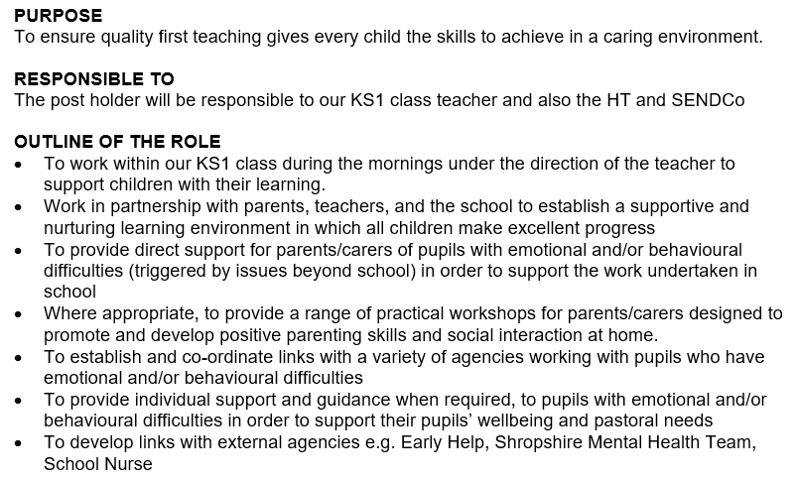
Job description

Slide 5
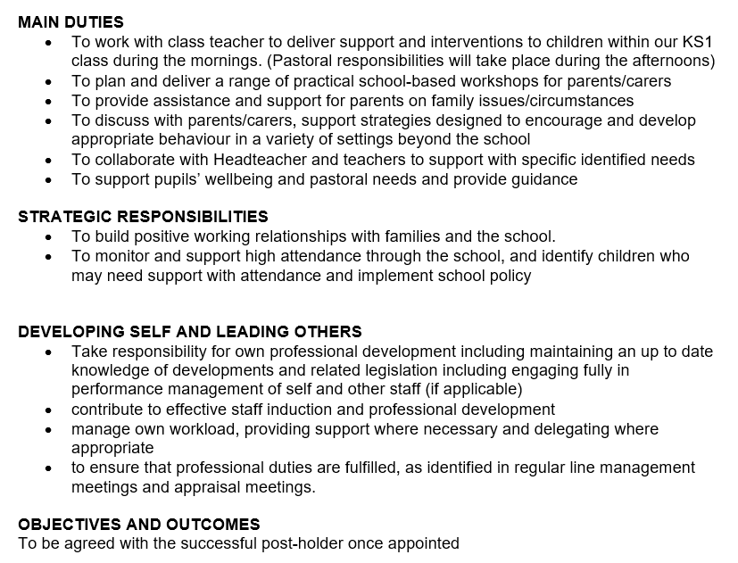
Job description

Slide 6
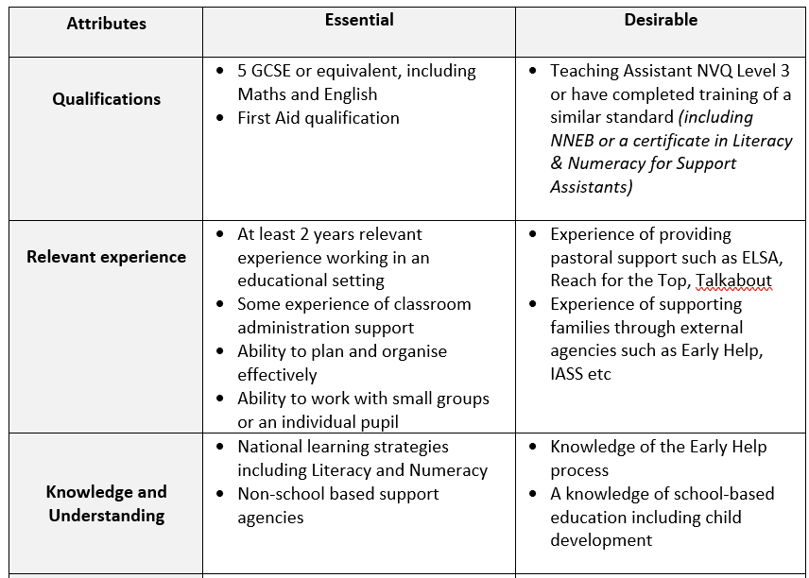
Person Specification

Slide 7
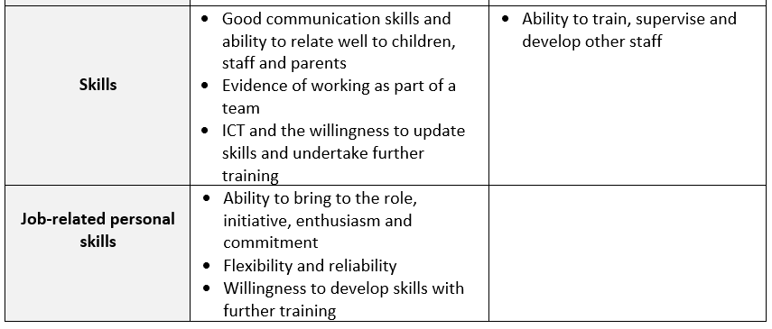
Person Specification

Slide 8
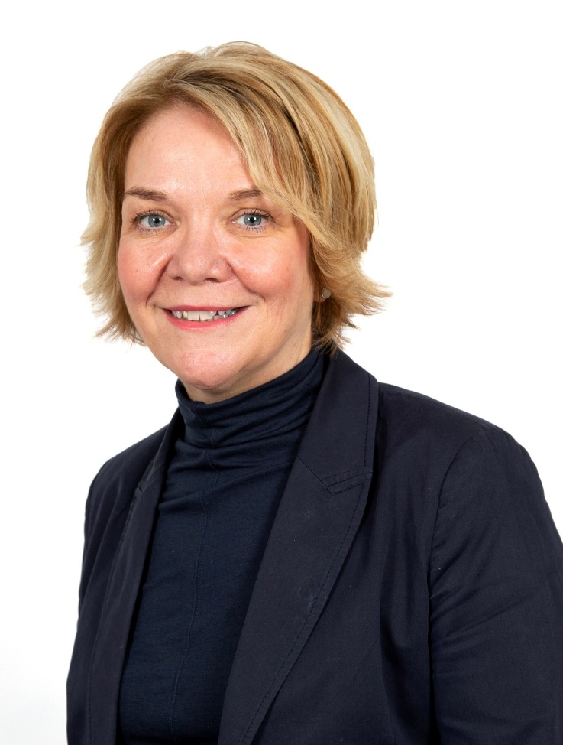
Welcome from the CEO
This is a high achieving Trust that is imaginative and creative in its approach to teaching and learning and is keen to look for continued sustained improvement.
Our vision ‘Achievement through Caring’ is central to all that we do at The Marches Academy Trust. Our schools are, innovative and striving to ensure that young people make the very most of their learning adventure and are equipped with the skills required to prosper in the modern world.
We are immensely proud of the Alliance of Leading Learning who provide a wide range of professional development opportunities across our Trust, nationally and internationally.
Our family of schools currently includes:
The Marches School and Sixth Form in Oswestry
Sir John Talbot’s School and Sixth Form in Whitchurch
Tilstock CE Primary School and Nursery in Whitchurch
The Grove School and Sixth Form in Market Drayton
Lower Heath CE Primary School and Nursery in Lower Heath
Shrewsbury Academy in Shrewsbury
Longlands Primary School and Nursery in Market Drayton
Grange Primary School and Nursery in Shrewsbury
Oakmeadow CE Primary School and Nursery in Shrewsbury
Woodlands School in Wem
Idsall School and Sixth Form in Shifnal
CEO
The Marches Academy Trust

Slide 9
Meet our Chair of Trustees
Thank you for your interest in this role.
The Trust is looking to appoint an individual to build on our Trust's current strengths and achievements.
As a thriving Trust serving over 6,000 students and their families in Shropshire, this a pivotal role in driving continuous improvement across our schools and will contribute to our vision of 'achievement through caring'.
Collaborative working with other schools in our Trust offers many benefits for students and staff; sharing best practice in teaching and learning, curriculum collaboration, extracurricular opportunities, staff development, finance and human resources, legal services, school improvement structures and governance arrangements.
We hope that the opportunity to shape the work of our schools and their staff to harness their professional expertise, with the goal of securing excellent outcomes, is one you would relish.
The prospect of this role goes beyond the immediate job description. The successful candidate will influence and help shape the strategy of the Trust, have the opportunity to support our ITT provision, support leadership development and career paths as well as drive efficiencies across our schools.
For the right individual, this is an exceptional opportunity. The right candidate will have no better chance of working with wonderful students, super staff and shaping our Trust into the future.
Chair of Trustees

Slide 10
Our Trust Vision Statement and Values
Achievement through caring
As a Trust, it’s our mission to empower everyone in our Trust and our communities to live and breathe our values and Achievement Through Caring, to reach their full potential.

Slide 11
Our investment in you
Talent Spotting our Future Leaders
Our Talent Pathway supports the professional development of staff within the trust. We identify leadership talent and leadership needs for future succession planning – ensuring relevant and practical leadership development opportunities for staff.
Our talent management programme and our Career Development Pathways provide a framework for the discussion of your leadership journey and the professional learning you can access along the way.
Talent Contract
The Talent contract is a promise; a covenant between yourself and the trust that the Trust will do its’ very best to support and develop you professionally. The Contract describes a variety of Professional development opportunities and encourages you to identify and pursue your training needs.
We believe successful creative lifelong learners participate in a journey of self-discovery. They know how to learn, acquire skills and feel safe to take risks with confidence and courage.

Slide 12
Our investment in you
Generous non-contact time for staff
We really care about employee wellbeing and our commitment is set out in our Wellbeing Policy and Charter. This commitment is underpinned by our four pillars of wellbeing;
Emotional Some examples include a robust induction programme, Trust newsletter, professional performance reviews(appraisal) and line manager check-in meeting. We have clear policies and procedures relating to all aspects of your employment and we carry out an annual well-being survey to gauge the health of our staff.
Physical We are blessed that our schools are located in beautiful Shropshire market towns and /or rural locations. We can offer discounted local gyms and onsite facilities in our secondary schools.
Financial We offer membership to two great pension schemes; Local government pension scheme and Teachers’ pension scheme. Our terms and conditions are aligned to Burgundy Book &School Teachers Pay & Conditions Document (teachers) and NJC Green Book (associate staff). We also recognise continuous service for sickness, maternity and annual leave entitlements for those transferring under the Redundancy payments (local government) Modification Order (RPMO).
Social Encouragement of great working relationships and sense of belonging through team building events, PD days, end of term events and Trust Awards evening.
Wellbeing Offer We are delighted that our wellbeing offer includes access to a free confidential medical and wellbeing service with School’s Advisory Service (SAS) for all staff. Services available include counselling, bereavement counselling, physiotherapy, menopause support and stress awareness sessions. We encourage staff to utilize SAS in seeking out preventative and early intervention by making support easily accessible for all!

Slide 13
We are a school led inclusive partnership representing all phases and school contexts nationally and internationally. Our core team at The Marches Academy Trust have trained over 400 ITT and over 150 School Direct students; we have also led the professional learning of over 5,000 educational leaders and governors.
We deliver the DfE National Professional Qualifications, and we actively encourage our staff to complete an NPQ programme at their earliest opportunity.
We also talent spot, from within our Trust team, colleagues who want to share their expertise and enhance their experiences by becoming an Improvement Consultant.
Supporting schools, departments and individuals across the Trust and also external schools.
Embracing all our work is the unique Professional Learning Conference we host each year which continues to inspire school colleagues nationally.
In joining The Marches Academy Trust you have direct access to an outward facing large group of outstanding schools across the West Midlands and beyond.
Quite simply we want to ensure the right expertise exists to enhance a self-improving system and impact learners, leaders and schools to drive continuous improvement.
You will be part of this success story as a member of our team; and on starting your new post you will also be starting your learning journey - with all the benefits of being part of a large and successful Trust with exemplary partnerships nationally and internationally.
We hold true to delivering current, inspirational training that has real impact back in the workplace. Most importantly our
participants confirm in countless testimonials that we invest in their leadership journey. Cavelle Priestley-Bird, Executive Director of People and Development)

Slide 14
Bits you need to know
The Marches Academy Trust values each person equally. We are committed to building a diverse team and embedding a welcoming, inclusive culture that encourages diversity and authenticity. We believe this will encourage creative ways of thinking – ensuring we collaborate more effectively and achieve better outcomes. We welcome applicants from all qualified candidates who share this commitment.
Everyone within our Academy Trust shares the objective to help keep children and young people safe by contributing to:
Providing a safe environment for children and young people to learn in an education setting and identifying those who are suffering or likely to suffer significant harm, taking appropriate action with the aim of ensuring they are kept safe both at home and within the education setting and we expect all staff to share this commitment. Shortlisted applicants will be asked to declare any criminal convictions and will be subject to online checks. The successful applicant will be subject to an enhanced DBS check.
“This post is exempt from the Rehabilitation of Offenders Act 1974 and as such all applicants who are appointed to this post will be subject to an Enhanced Disclosure from the Criminal Records Bureau before the appointment is confirmed. This check will include details of cautions, reprimands or warnings, as well as convictions and non-conviction information. Once provisionally appointed, the successful applicant may also be required to apply for an Enhanced Disclosure at predetermined intervals during the course of their employment whilst in this post.”

