Slide 1
SCIENCE Technician
Recruitment pack
December 2024

Slide 2
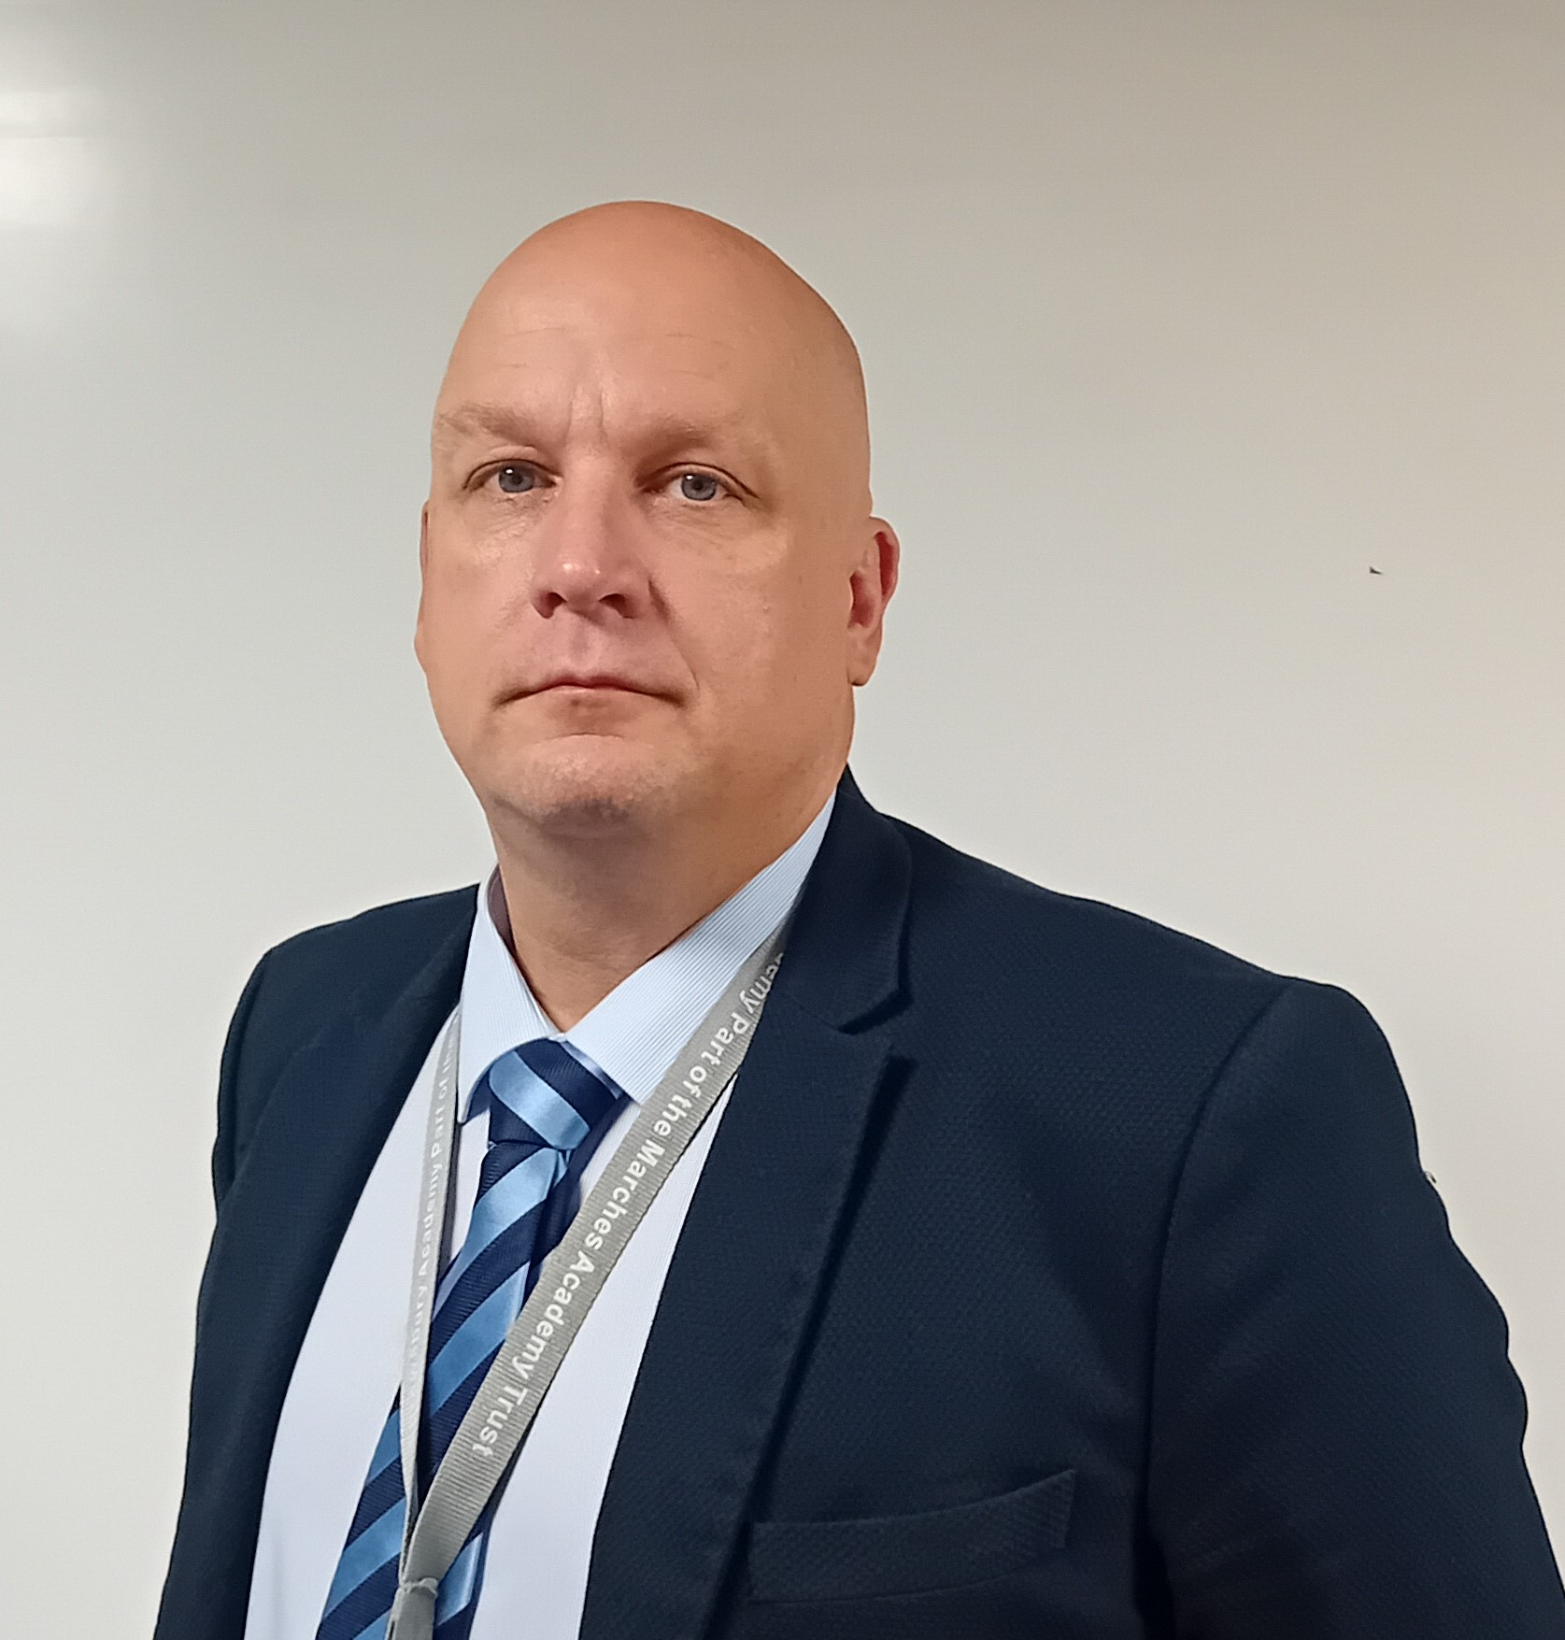
Meet our Headteacher
Welcome to our school.
Our mission is to enable young people to be successful, creative, lifelong learners participating in a journey of self-discovery through the Trust vision of ‘Achievement through caring’.
Our inclusive, truly comprehensive school has come through a period of transition setting us up to where we are now with the school moving forward at pace, ensuring our students have access to a first-class education.
We work closely with our community to give students lots of opportunities and new experiences that fit hand in hand with traditional values around behaviour, manners and respect.
Students are happy here; they tell us they feel safe and enjoy school where our rich and varied curriculum that finds the talent in everyone.
We work to develop a love for learning so that our young people are driven to seek educational experiences that both inspire and challenge them as they progress throughout the school, and beyond.
This is an exciting time to join us, with an extensive new build already underway and lots of opportunities and support to develop your career as you join our team of committed, dedicated and supportive staff.
We are excited to receive your application and would love to meet you to share “Proud of SA” in action.
Jim Taylor
Headteacher

Slide 3
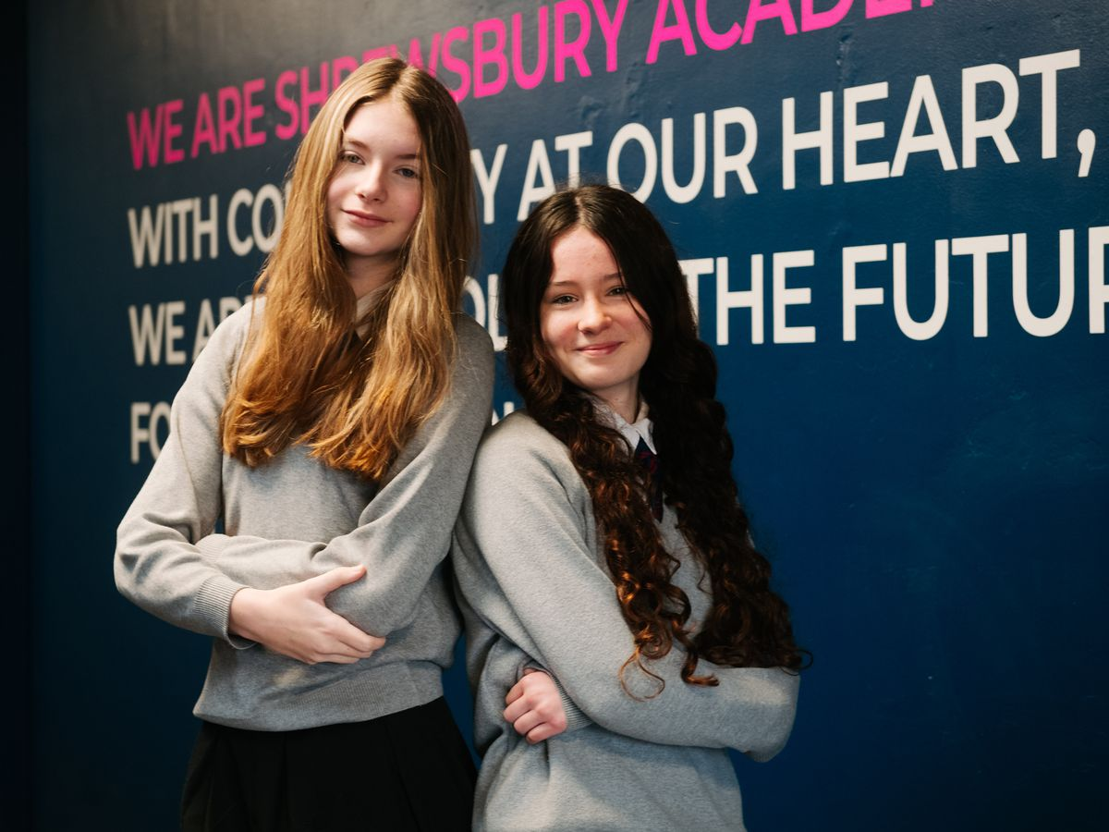
Job description
We offer
  An ‘Outstanding’ curriculum and learning experience for our young people.
  Excellent professional learning and support
  at every stage in your career, with
  opportunity for continued personal development through our Talent Pathway Career development opportunities including funded NPQ qualifications.
  An enthusiastic and supportive team of staff, parents and governors
  A core belief in staff wellbeing and work
  life balance for all, evidenced in policy
  and practice.
  Benefits including funded counselling, physiotherapy, assess to GP consultations and other medical support.
  Laptop for work and personal use.
  Purpose
  Are you a positive, practical forward thinker, with the ability to communicate with young people?
Do you want to improve the life chances of our young people and prepare them for the wider world?
  You will play a pivotal role on our journey to continuous improvement and outcomes, as we continue to drive a strong education for the community of Shrewsbury
  Why this role above others?
A supportive environment with an experienced team where you will be invested in and valued
A varied and exciting role – building relationships with a range of colleagues across the Multi-Academy Trust
A varied day with different experiences and challenges
  Any questions in regard to the role can
  be raised with, Sarah Compton on sarah.compton@shr.mmat.co.uk ahead of the
  closing date:
Post title
Science Technician
Salary
Grade 7, Point 12 - 17 (£27,711 - £30.060)
(£14.37 - £15.58 per hour_
Hours of work
37 per week
Post status
Permanent

Slide 4
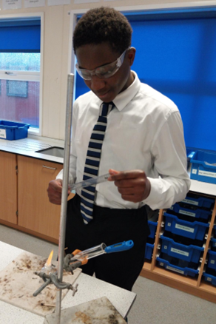
  Responsible to:
Director and Deputy Director of Science
  Outline of role:
Provision of support services to teaching staff in organising requirements for practical lessons.
Overcome barriers to learning to and ensure all children are resilient learners who feel happy, safe and make progress in the school environment.
  Main duties:
Create and maintain a purposeful, orderly and productive working environment.
Preparation of materials to exact specification from stock as directed, and clearing away equipment.
Timely and accurate preparation and use of specialist equipment/resources/materials as required by staff/curriculum/lesson plans etc.
Assistance to teaching staff with demonstration lessons and practical sessions
Oversight of maintenance and repair services to equipment and working surfaces.
Assisting in maintaining safety standards in the Faculty.
  Curriculum development
  Contribute to the team responsibility for a subject or aspect of the school’s work and develop plans which identify clear targets and success criteria for its development and/or preservation.
  Contribute to whole school’s development activities.
  Standards and quality assurance
  Uphold department, school and Trust procedures, policies and plans.
  Represent the department in cross-curricular working parties.
  Attend Department, Year Team meetings and events to fully support the department, the school and the Multi-Academy Trust.
  Attend relevant CPD and meetings within the Trust and with
  outside agencies.

Slide 5
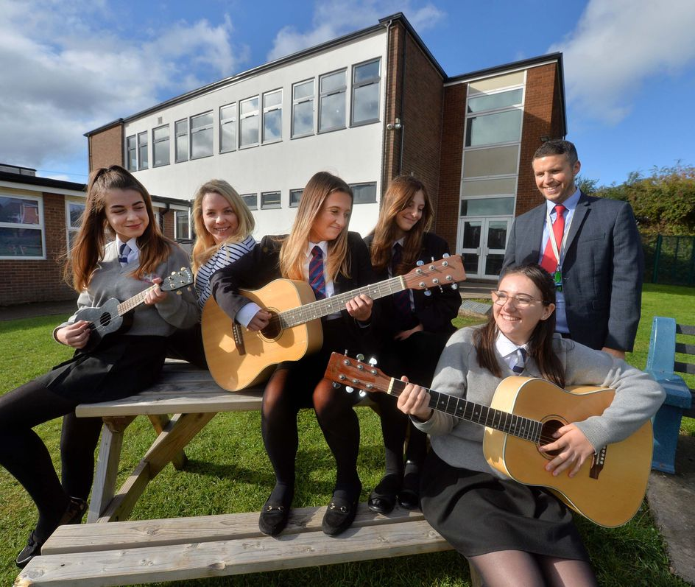
  Developing self and leading others:
  Take responsibility for own professional development including maintaining an up to date knowledge of developments and related legislation including engaging fully in performance management of self and other staff (if applicable)
  Contribute to effective staff induction and professional development
  Manage own workload, providing support where necessary and delegating where appropriate to ensure that professional duties are fulfilled, as identified
  Community responsibilities:
  Effective dialogue with parents in accordance with school policies.
  Attend and support community events if required.
  In addition to the above all Marches Academy Trust staff
  are required to:
  Adhere to policies and procedures, including Equality and Diversity and Health and Safety.
  Respect confidentiality: all confidential information should be kept in confidence and not released to unauthorised persons.
  Undertake appropriate training and development as required.
  Participate in the Performance Review Cycle.
  Demonstrate excellent Customer Care in dealing with all customers.
  Ensure positive effective working relationships with the school teams, stakeholders and partners.
  Objectives and outcomes:
  To be agreed with the successful post-holder once appointed.
  The duties may be varied to meet the changing demands of the school at the reasonable discretion of the Headteacher.
  The post holder may have opportunities to work in other schools within The Marches Academy Trust.

Slide 6
Person specification
 | Essential | Desirable
Qualifications and training | Good Standard of Education 5 GCSE’s or Equivalent including English or Maths (or relevant subject qualification) | First Aid qualification. NVQ Level 2 or Equivalent
Experience | General technical / resource support Keyboard / computer skills Supporting in the administration of a department. | Experience of working in an educational setting or other relevant environment
Knowledge | Current developments in Science . | Knowledge of particular subject / technical area

Slide 7
Person specification
 | Essential | Desirable
Skills | Show commitment to meeting the needs of the school. Willingness to participate in training and development opportunities. Good ICT Skills Good numeracy and literacy skills. | Use of relevant equipment / resources
Personal qualities | Enthusiasm, energy, and commitment. Awareness of the needs of others. A high level of professionalism in manner and organisation. An ability to draw together different disciplines to work to a common aim. A willingness to contribute to whole school issues
In addition to candidates’ ability to perform the duties of the post, the interview will also explore issues relating to safeguarding and promoting the welfare of children including:
  Motivation to work with children and young people
  Ability to form and maintain appropriate relationships and personal boundaries with children and young people
  Emotional resilience in working with challenging behaviour, and
  Attitudes to use of authority and maintaining discipline

Slide 8
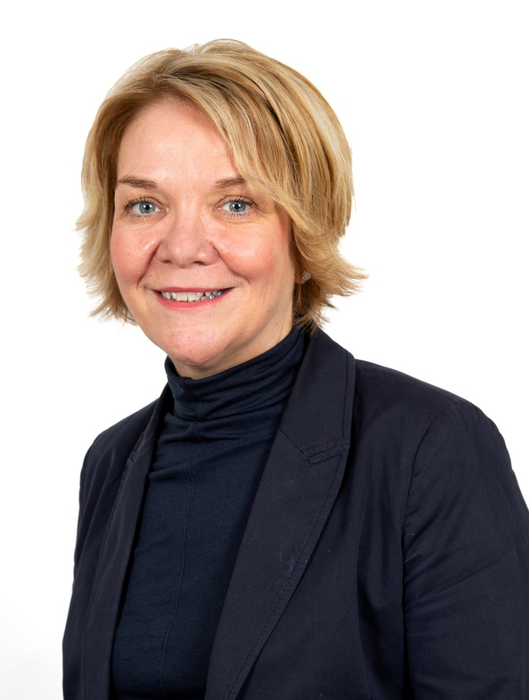

Welcome from the CEO
This is a high achieving Trust that is imaginative and creative in its approach to teaching and learning
and is keen to look for continued sustained improvement.
Our vision ‘Achievement through Caring’ is central to all that we do at The Marches Academy Trust. Our schools are, innovative and striving to ensure that young people make the very most of their learning adventure and are equipped with the skills required to prosper in the modern world.
We are immensely proud of the Alliance
of Leading Learning who provide a wide
range of professional development opportunities across our Trust, nationally
and internationally.
Our family of schools currently includes:
  The Marches School and Sixth Form
  in Oswestry
  Sir John Talbot’s School and Sixth Form
  in Whitchurch
  Tilstock CE Primary School and Nursery
  in Whitchurch
  The Grove School and Sixth Form
  in Market Drayton
  Lower Heath CE Primary School and Nursery
  in Lower Heath
  Shrewsbury Academy in Shrewsbury
  Longlands Primary School and Nursery
  in Market Drayton
  Grange Primary School and Nursery
  in Shrewsbury
  Oakmeadow CE Primary School and Nursery
  in Shrewsbury
  Woodlands School in Wem
  Idsall School and Sixth Form in Shifnal
CEO
The Marches Academy Trust

Slide 9
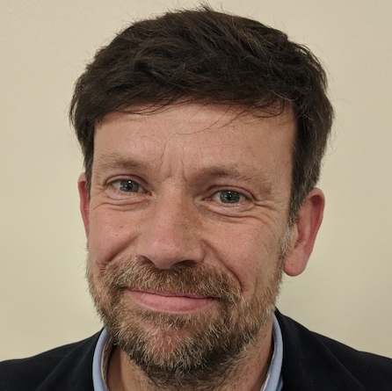

Meet our Chair of Trustees
Thank you for your interest in this role.
The Trust is looking to appoint an individual to build on our Trust's current strengths and achievements.
As a thriving Trust serving over 6,000 students and their families in Shropshire, this a pivotal role in driving continuous improvement across our schools and will contribute to our vision of 'achievement through caring'.
Collaborative working with other schools in our Trust offers many benefits for students and staff; sharing best practice in teaching and learning, curriculum collaboration, extracurricular opportunities, staff development, finance and human resources, legal services, school improvement structures and governance arrangements.
We hope that the opportunity to shape the work of our schools and their staff to harness their professional expertise, with the goal of securing excellent outcomes, is one you would relish.
The prospect of this role goes beyond the immediate job description. The successful candidate will influence and help shape the strategy of the Trust,
have the opportunity to support our ITT provision, support leadership development and career paths as well as drive efficiencies across our schools.
For the right individual, this is an exceptional opportunity. The right candidate will have no better chance of working with wonderful students, super staff and shaping our Trust into the future.
Chair of Trustees

Slide 10

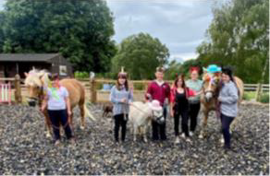
Who we are
Check out our video:
https://youtu.be/Ej3JREWUyrA
Interested? Here’s how to apply:
Complete the Online Application Form
The closing date for applications is:
26th February 2025
Interviews will be held:
6th March 2025
The Trust is committed to safeguarding and promoting
the welfare of the children in our care and expect all
staff to share this commitment.
Welcome to the Marches Academy Trust!
We are a multi-academy sponsor based in Shropshire, currently comprising five secondary schools, five primary schools and one special school.
Across our Trust we have a wealth of experience to inspire and motivate children, young people and staff to be the very best they can.
Achievement Through Caring drives our Trust, and our values are shared throughout our family of schools; we work together on embedding them in everything we do.
Our Trust prides itself on delivering high quality
education and connecting with our children and young people to inspire and enthuse them to learn, achieve and to be happy.
A core belief in staff wellbeing and work life balance evidenced in policy and practice

Slide 11








Our Trust Vision Statement and Values
Achievement through caring
As a Trust, it’s our mission to empower everyone in our Trust and our communities to live and breathe our values and Achievement Through Caring, to reach their full potential.

Slide 12
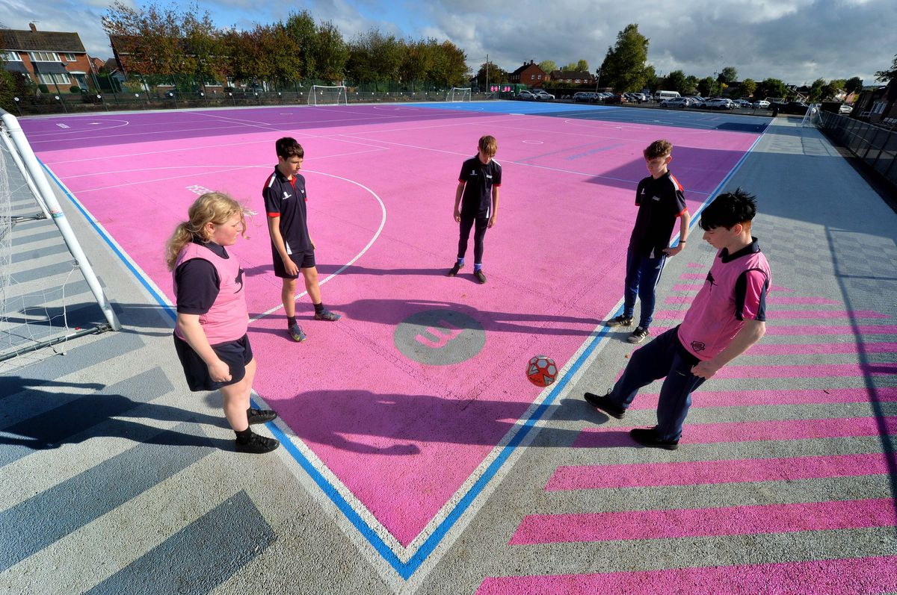
Our investment in you
Talent Spotting our Future Leaders
Our Talent Pathway supports the professional development of staff within the trust. We identify leadership talent and leadership needs for future succession planning – ensuring relevant and practical leadership development opportunities for staff.
Our talent management programme and our Career Development Pathways provide a framework for the discussion of your leadership journey and the professional learning you can access along the way.
Talent Contract
The Talent contract is a promise; a covenant between yourself and the trust that the Trust will do its’ very best to support and develop you professionally. The Contract describes a variety of Professional development opportunities and encourages you to identify and pursue your training needs.
We believe successful creative lifelong learners participate in a journey of self-discovery. They know how to learn, acquire skills
and feel safe to take risks with confidence and courage.

Slide 13


Our investment in you
Generous non-contact time for staff
We really care about employee wellbeing and our commitment is setout in our Wellbeing Policy and Charter. This commitment is underpinned by our four pillars of wellbeing;
  Emotional
  Some examples include a robust induction programme, Trust newsletter, professional performance reviews(appraisal) and line manager check-in meeting. We have clear policies and procedures relating to all aspects of your employment and we carry out an annual well-being survey to gauge the health of our staff.
  Physical
  We are blessed that our schools are located in beautiful Shropshire market towns and /or rural locations. We can offer discounted local gyms and onsite facilities in our secondary schools.
  Financial
  We offer membership to two great pension schemes; Local government pension scheme and Teachers’ pension scheme. Our terms and conditions are aligned to Burgundy Book &School Teachers Pay & Conditions Document (teachers) and NJC Green Book (associate staff). We also recognise continuous service for sickness, maternity and annual leave entitlements for those transferring under the Redundancy payments (local government) Modification Order (RPMO).
  Social
  Encouragement of great working relationships and sense of belonging through team building events, PD days, end of term events and Trust Awards evening.
Wellbeing Offer
We are delighted that our wellbeing offer includes
access to a free confidential medical and wellbeing
service with School’s Advisory Service (SAS) for all staff. Services available include counselling, bereavement counselling, physiotherapy, menopause support and stress awareness sessions. We encourage staff to utilize SAS in seeking out preventative and early intervention by making support easily accessible for all!

Slide 14
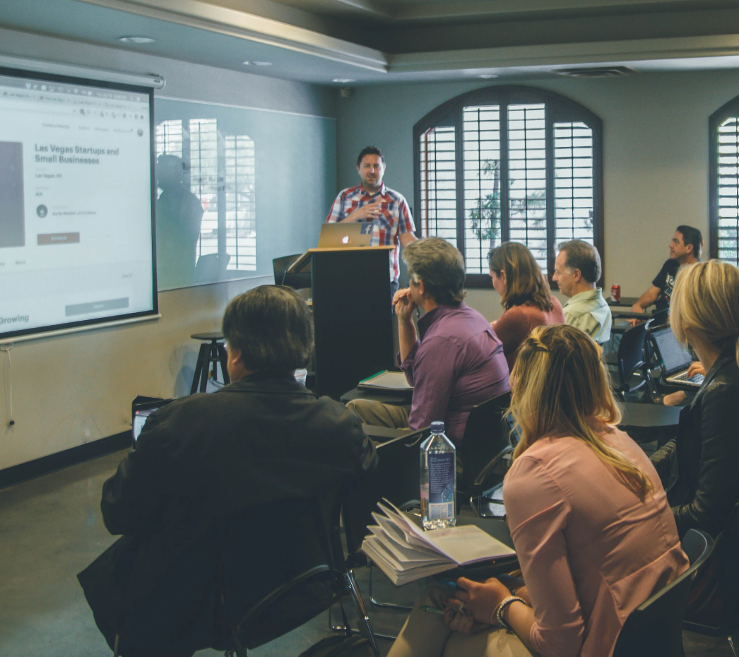
We are a school led inclusive partnership representing all phases and school contexts nationally and internationally. Our core team at The Marches Academy Trust have trained over 400 ITT and over 150 School Direct students; we have
also led the professional learning of over 5,000 educational leaders and governors.
We deliver the DfE National Professional Qualifications, and we actively encourage our staff to complete an NPQ programme at their earliest opportunity.
We also talent spot, from within our Trust team, colleagues who want to share their expertise and enhance their experiences by becoming an Improvement Consultant.
Supporting schools, departments and individuals across the Trust and also
external schools.
Embracing all our work is the unique Professional Learning Conference we host each year which continues to inspire school colleagues nationally.
In joining The Marches Academy Trust you have direct access to an outward facing large group of outstanding schools across the West Midlands and beyond.
Quite simply we want to ensure the right expertise exists to enhance a self-improving system and impact learners, leaders and schools to drive
continuous improvement.
You will be part of this success story as a member of our team; and on starting your new post you will also be starting your learning journey - with all the benefits of being part of a large and successful Trust with exemplary partnerships nationally and internationally.
We hold true to delivering current, inspirational training that has real impact back in the workplace. Most importantly our
participants confirm in countless testimonials that we invest in their leadership journey.
Cavelle Priestley-Bird, Executive Director
of People and Development)

Slide 15
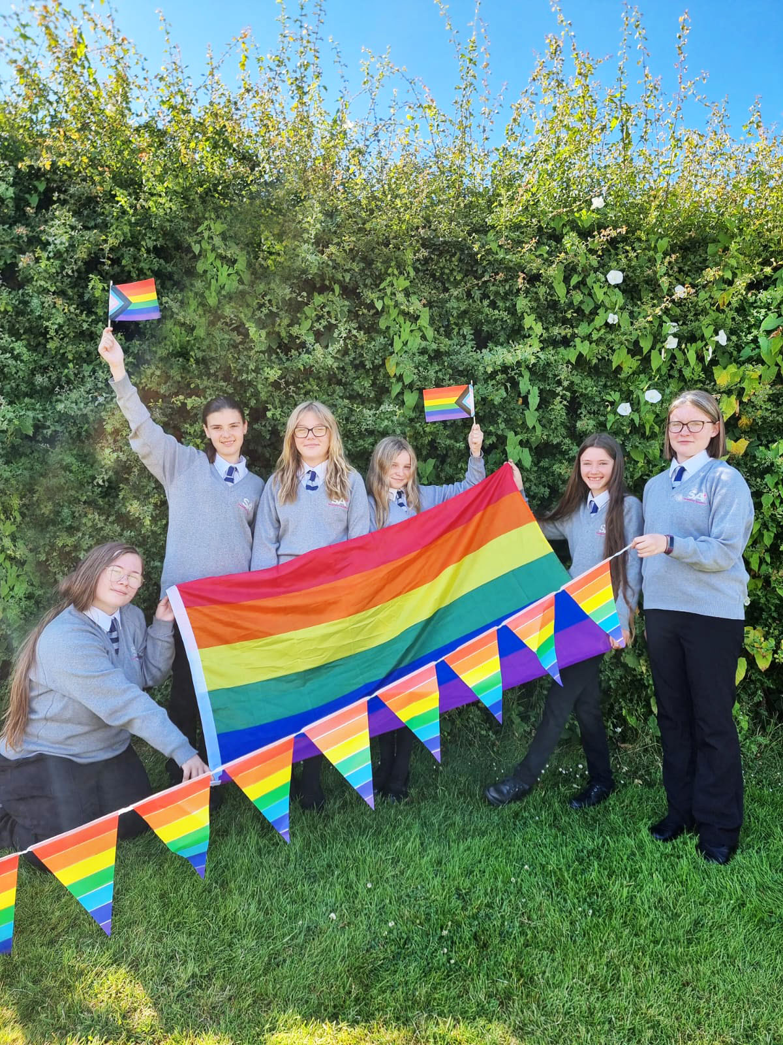
Bits you need to know
The Marches Academy Trust values each person equally. We are committed to building a diverse team and embedding a welcoming, inclusive culture that encourages diversity and authenticity. We believe this will encourage creative ways of thinking – ensuring we collaborate more effectively and achieve better outcomes. We welcome applicants from all qualified candidates who share this commitment.
Everyone within our Academy Trust shares the objective to help keep children and young people safe by contributing to:
Providing a safe environment for children and young people to learn in an education setting and identifying those who are suffering or likely to suffer significant harm, taking appropriate action with the aim of ensuring they are kept safe both at home and within the education setting and we expect all staff to share this commitment. Shortlisted applicants will be asked to declare any criminal convictions and will be subject to online checks. The successful applicant will be subject to an enhanced DBS check.
“This post is exempt from the Rehabilitation of Offenders Act 1974 and as such all applicants who are appointed to this post will be subject to an Enhanced Disclosure from the Criminal Records Bureau before the appointment is confirmed. This check will include details of cautions, reprimands or warnings, as well as convictions and non-conviction information. Once provisionally appointed, the successful applicant may also be required to apply for an Enhanced Disclosure at predetermined intervals during the course of their employment whilst in this post.”

