Slide 1
TEACHER OF GIRLS PE
Recruitment pack
May 2025

Slide 2
Meet our Headteacher
Welcome to our school.
Our mission is to enable young people to be successful, creative, lifelong learners participating in a journey of self-discovery through the Trust vision of ‘Achievement through caring’.
Our inclusive, truly comprehensive school has come through a period of transition setting us up to where we are now with the school moving forward at pace, ensuring our students have access to a first-class education.
We work closely with our community to give students lots of opportunities and new experiences that fit hand in hand with traditional values around behaviour, manners and respect.
Students are happy here; they tell us they feel safe and enjoy school where our rich and varied curriculum that finds the talent in everyone.
We work to develop a love for learning so that our young people are driven to seek educational experiences that both inspire and challenge them as they progress throughout the school, and beyond.
This is an exciting time to join us, with an extensive new build already underway and lots of opportunities and support to develop your career as you join our team of committed, dedicated and supportive staff.
We are excited to receive your application and would love to meet you to share “Proud of SA” in action.
Jim Taylor
Headteacher

Slide 3
Job description
We offer
• An ‘Outstanding’ curriculum and learning experience for our young people.
• Excellent professional learning and support at every stage in your career, with opportunity for continued personal development through our Talent Pathway Career development opportunities including funded NPQ qualifications.
• An enthusiastic and supportive team of staff, parents and governors
• A core belief in staff wellbeing and work life balance for all, evidenced in policy and practice.
• Benefits including funded counselling, physiotherapy and GP and other medical support..
Purpose
Inspire students to embrace health, confidence, and teamwork through Physical Education. Shape their future today. Do you wish to take the next step in your career and be a part of a department where learning provides opportunities to explore, experiment an reflect? You will play a pivotal role on our journey to continuous improvement and outcomes, as we continue to drive a strong education for the community of Shrewsbury.
Why this role above others?
You will be part of a team that has a variety of specialised teachers, all offering support and guidance to each other, which creates a positive and hardworking ethos. They go above and beyond to ensure that all students achieve.
Any questions regarding this role can be sent to Kris Dobston, Director of PE. ahead of the closing date: kris.dobson@shr.mmat.co.uk
Post title
Teacher of Girls PE
Salary
MPR/UPR (£30,000-46,525)
Hours of work
1.0 FTE
Post status
Permanent

Slide 4
Responsible to: Director of Physical Education
Outline of role:
• Deliver an exciting curriculum of Physical Education to Key Stage 3 and Key Stage 4. • Barriers to learning and ensure all children are resilient learners who feel happy, safe and make progress in the school environment
Main duties: • Teach at Key Stage 3 and Key Stage 4. • Contribute to other areas of the curriculum as where necessary. • Assist in establishing faculty aims and objectives. • Support in the organisation of examinations for all year groups, including teacher assessments, GCSE, and other vocational qualifications. • Support the faculty in cross-curricular working parties and work with outside organisations to enrich the experience of students. • Participate in team meetings and briefings at appropriate points during the academic year. • Support the review process to evaluate and develop curriculum materials, procedures, and strategies to meet these objectives. • Support in establishing appropriately high levels of expectation by setting down clear guidelines for establishing good standards of behaviour and achievement within the faculty, including the careful presentation of work and the care of books and equipment.
Teaching and learning
• Adhere to Teaching Standards. • Maintain behaviour for learning, in accordance with the school’s procedures. • Encourage good practice with regard to punctuality, behaviour, standards of work and homework. • Contribute to the development of schemes of work, assessments, resources and displays. • Keep up to date with marking, assessments and data entry. • Keep an accurate teaching record.
Curriculum development • Contribute to the team responsibility for a subject or aspect of the school’s work and develop plans which identify clear targets and success criteria for its development and/or preservation. • Contribute to whole school’s development activities.
Standards and quality assurance • Uphold department, school and Trust procedures, policies and plans. • Represent the department in cross-curricular working parties. • Attend Department, Year Team meetings and events to fully support the department, the school and the Multi-Academy Trust. • Attend relevant CPD and meetings within the Trust and with outside agencies

Slide 5
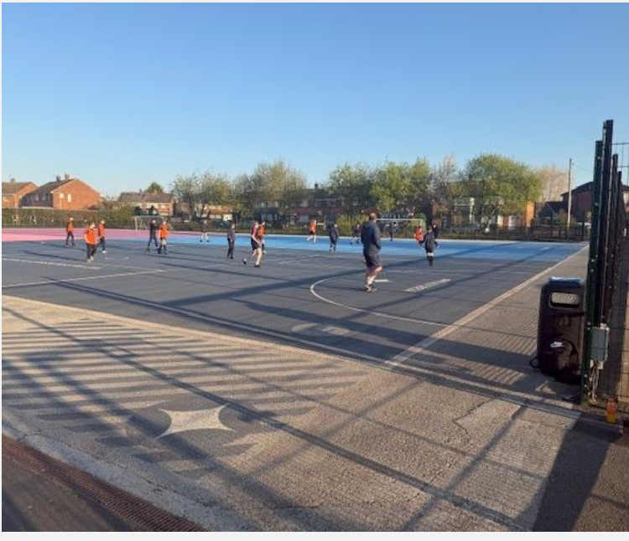
Developing self and leading others:
Take responsibility for own professional development including maintaining an up to date knowledge of developments and related legislation including engaging fully in performance management of self and other staff (if applicable)
Contribute to effective staff induction and professional development
Manage own workload, providing support where necessary and delegating where appropriate to ensure that professional duties are fulfilled, as identified
Community responsibilities:
Effective dialogue with parents in accordance with school policies.
Attend and support community events if required.
In addition to the above all Marches Academy Trust staff are required to:
Adhere to policies and procedures, including Equality and Diversity and Health and Safety.
Respect confidentiality: all confidential information should be kept in confidence and not released to unauthorised persons.
Undertake appropriate training and development as required.
Participate in the Performance Review Cycle.
Demonstrate excellent Customer Care in dealing with all customers.
Ensure positive effective working relationships with the school teams, stakeholders and partners.
Objectives and outcomes:
To be agreed with the successful post-holder once appointed.
The duties may be varied to meet the changing demands of the school at the reasonable discretion of the Headteacher.
The post holder may have opportunities to work in other schools within The Marches Academy Trust.

Slide 6
Person specification
 | Essential | Desirable
Qualifications and training | QTS (Secondary age range) Degree Level (or equivalent qualification) | Further professional qualifications e.g. Leadership Pathways, NPQH and MA/PHD
Experience | Teaching in comprehensive school (s) across the age and ability range Motivating students and enabling them to enjoy learning. Supporting in the development of curriculum materials.. | Form Tutor Experience A portfolio of relevant resources showing teaching and learning strategies.
Knowledge | Current developments in teaching in Physical Education. The range of teaching strategies and classroom organisation open to teachers. The range of learning strategies that can be employed by students. An understanding of target setting and its use in raising aspirations.

Slide 7
Person specification
 | Essential | Desirable
Skills | Show commitment to meeting the needs of the student. Initiate curriculum planning. Support with the process of curriculum development and assessment for learning. See take undertaken through to completion. Ability to use ICT effectively to promote high quality teaching.
Personal qualities | Enthusiasm, energy, and commitment. Awareness of the needs of others. A high level of professionalism in manner and organisation. An ability to draw together different disciplines to work to a common aim. A willingness to contribute to whole school issues
In addition to candidates’ ability to perform the duties of the post, the interview will also explore issues relating to safeguarding and promoting the welfare of children including:
Motivation to work with children and young people
Ability to form and maintain appropriate relationships and personal boundaries with children and young people
Emotional resilience in working with challenging behaviour
Attitudes to use of authority and maintaining discipline

Slide 8
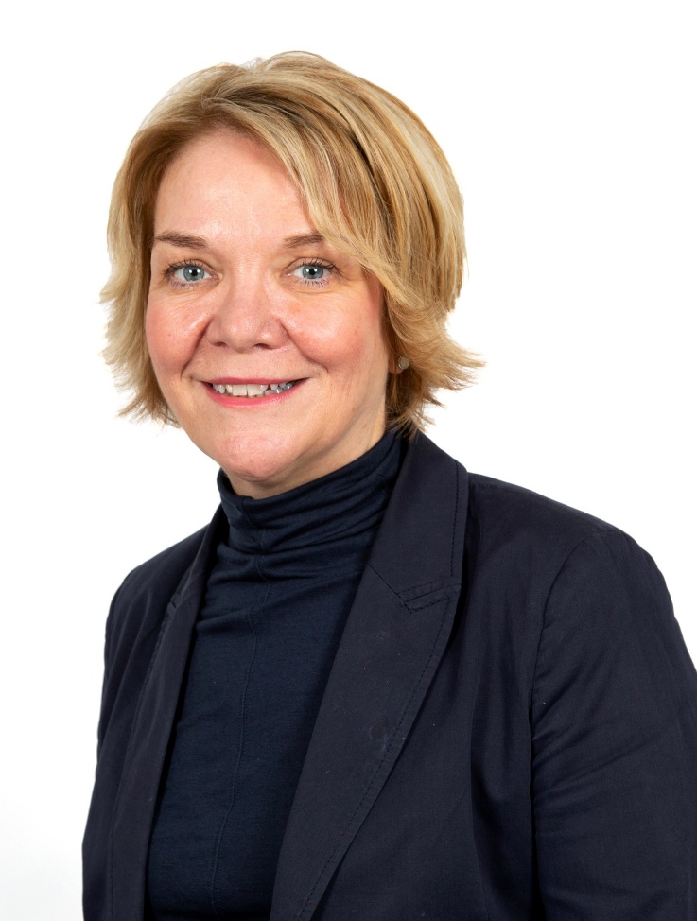
Welcome from the CEO
This is a high achieving Trust that is imaginative and creative in its approach to teaching and learning and is keen to look for continued sustained improvement.
Our vision ‘Achievement through Caring’ is central to all that we do at The Marches Academy Trust. Our schools are, innovative and striving to ensure that young people make the very most of their learning adventure and are equipped with the skills required to prosper in the modern world.
We are immensely proud of the Alliance of Leading Learning who provide a wide range of professional development opportunities across our Trust, nationally and internationally.
Our family of schools currently includes:
The Marches School and Sixth Form in Oswestry
Sir John Talbot’s School and Sixth Form in Whitchurch
Tilstock CE Primary School and Nursery in Whitchurch
The Grove School and Sixth Form in Market Drayton
Lower Heath CE Primary School and Nursery in Lower Heath
Shrewsbury Academy in Shrewsbury
Longlands Primary School and Nursery in Market Drayton
Grange Primary School and Nursery in Shrewsbury
Oakmeadow CE Primary School and Nursery in Shrewsbury
Woodlands School in Wem
Idsall School and Sixth Form in Shifnal
CEO
The Marches Academy Trust

Slide 9
Meet our Chair of Trustees
Thank you for your interest in this role.
The Trust is looking to appoint an individual to build on our Trust's current strengths and achievements.
As a thriving Trust serving over 6,000 students and their families in Shropshire, this a pivotal role in driving continuous improvement across our schools and will contribute to our vision of 'achievement through caring'.
Collaborative working with other schools in our Trust offers many benefits for students and staff; sharing best practice in teaching and learning, curriculum collaboration, extracurricular opportunities, staff development, finance and human resources, legal services, school improvement structures and governance arrangements.
We hope that the opportunity to shape the work of our schools and their staff to harness their professional expertise, with the goal of securing excellent outcomes, is one you would relish.
The prospect of this role goes beyond the immediate job description. The successful candidate will influence and help shape the strategy of the Trust,
have the opportunity to support our ITT provision, support leadership development and career paths as well as drive efficiencies across our schools.
For the right individual, this is an exceptional opportunity. The right candidate will have no better chance of working with wonderful students, super staff and shaping our Trust into the future.
Chair of Trustees

Slide 10
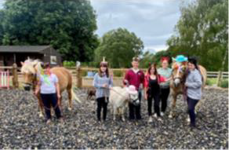
Who we are
Check out our video:
https://youtu.be/Ej3JREWUyrA
Interested? Here’s how to apply:
Complete the Online Application Form
The closing date for applications is:
18th May 2025
Interviews will be held:
22nd May 2025
The Trust is committed to safeguarding and promoting the welfare of the children in our care and expect all
staff to share this commitment.
Welcome to the Marches Academy Trust!
We are a multi-academy sponsor based in Shropshire, currently comprising five secondary schools, five primary schools and one special school.
Across our Trust we have a wealth of experience to inspire and motivate children, young people and staff to be the very best they can.
Achievement Through Caring drives our Trust, and our values are shared throughout our family of schools; we work together on embedding them in everything we do.
Our Trust prides itself on delivering high quality education and connecting with our children and young people to inspire and enthuse them to learn, achieve and to be happy.
A core belief in staff wellbeing and work life balance evidenced in policy and practice

Slide 11
Our Trust Vision Statement and Values
Achievement through caring
As a Trust, it’s our mission to empower everyone in our Trust and our communities to live and breathe our values and Achievement Through Caring, to reach their full potential.

Slide 12
Our investment in you
Talent Spotting our Future Leaders
Our Talent Pathway supports the professional development of staff within the trust. We identify leadership talent and leadership needs for future succession planning – ensuring relevant and practical leadership development opportunities for staff.
Our talent management programme and our Career Development Pathways provide a framework for the discussion of your leadership journey and the professional learning you can access along the way.
Talent Contract
The Talent contract is a promise; a covenant between yourself and the trust that the Trust will do its’ very best to support and develop you professionally. The Contract describes a variety of Professional development opportunities and encourages you to identify and pursue your training needs.
We believe successful creative lifelong learners participate in a journey of self-discovery. They know how to learn, acquire skills and feel safe to take risks with confidence and courage.

Slide 13
Our investment in you
Generous non-contact time for staff
We really care about employee wellbeing and our commitment is setout in our Wellbeing Policy and Charter. This commitment is underpinned by our four pillars of wellbeing;
Emotional Some examples include a robust induction programme, Trust newsletter, professional performance reviews(appraisal) and line manager check-in meeting. We have clear policies and procedures relating to all aspects of your employment and we carry out an annual well-being survey to gauge the health of our staff.
Physical We are blessed that our schools are located in beautiful Shropshire market towns and /or rural locations. We can offer discounted local gyms and onsite facilities in our secondary schools.
Financial We offer membership to two great pension schemes; Local government pension scheme and Teachers’ pension scheme. Our terms and conditions are aligned to Burgundy Book &School Teachers Pay & Conditions Document (teachers) and NJC Green Book (associate staff). We also recognise continuous service for sickness, maternity and annual leave entitlements for those transferring under the Redundancy payments (local government) Modification Order (RPMO).
Social Encouragement of great working relationships and sense of belonging through team building events, PD days, end of term events and Trust Awards evening.
Wellbeing Offer We are delighted that our wellbeing offer includes access to a free confidential medical and wellbeing service with School’s Advisory Service (SAS) for all staff. Services available include counselling, bereavement counselling, physiotherapy, menopause support and stress awareness sessions. We encourage staff to utilize SAS in seeking out preventative and early intervention by making support easily accessible for all!

Slide 14
We are a school led inclusive partnership representing all phases and school contexts nationally and internationally. Our core team at The Marches Academy Trust have trained over 400 ITT and over 150 School Direct students; we have also led the professional learning of over 5,000 educational leaders and governors.
We deliver the DfE National Professional Qualifications, and we actively encourage our staff to complete an NPQ programme at their earliest opportunity.
We also talent spot, from within our Trust team, colleagues who want to share their expertise and enhance their experiences by becoming an Improvement Consultant.
Supporting schools, departments and individuals across the Trust and also external schools.
Embracing all our work is the unique Professional Learning Conference we host each year which continues to inspire school colleagues nationally.
In joining The Marches Academy Trust you have direct access to an outward facing large group of outstanding schools across the West Midlands and beyond.
Quite simply we want to ensure the right expertise exists to enhance a self-improving system and impact learners, leaders and schools to drive continuous improvement.
You will be part of this success story as a member of our team; and on starting your new post you will also be starting your learning journey - with all the benefits of being part of a large and successful Trust with exemplary partnerships nationally and internationally.
We hold true to delivering current, inspirational training that has real impact back in the workplace. Most importantly our
participants confirm in countless testimonials that we invest in their leadership journey. Cavelle Priestley-Bird, Executive Director of People and Development)

Slide 15
Bits you need to know
The Marches Academy Trust values each person equally. We are committed to building a diverse team and embedding a welcoming, inclusive culture that encourages diversity and authenticity. We believe this will encourage creative ways of thinking – ensuring we collaborate more effectively and achieve better outcomes. We welcome applicants from all qualified candidates who share this commitment.
Everyone within our Academy Trust shares the objective to help keep children and young people safe by contributing to:
Providing a safe environment for children and young people to learn in an education setting and identifying those who are suffering or likely to suffer significant harm, taking appropriate action with the aim of ensuring they are kept safe both at home and within the education setting and we expect all staff to share this commitment. Shortlisted applicants will be asked to declare any criminal convictions and will be subject to online checks. The successful applicant will be subject to an enhanced DBS check.
“This post is exempt from the Rehabilitation of Offenders Act 1974 and as such all applicants who are appointed to this post will be subject to an Enhanced Disclosure from the Criminal Records Bureau before the appointment is confirmed. This check will include details of cautions, reprimands or warnings, as well as convictions and non-conviction information. Once provisionally appointed, the successful applicant may also be required to apply for an Enhanced Disclosure at predetermined intervals during the course of their employment whilst in this post.”

